Slide 1

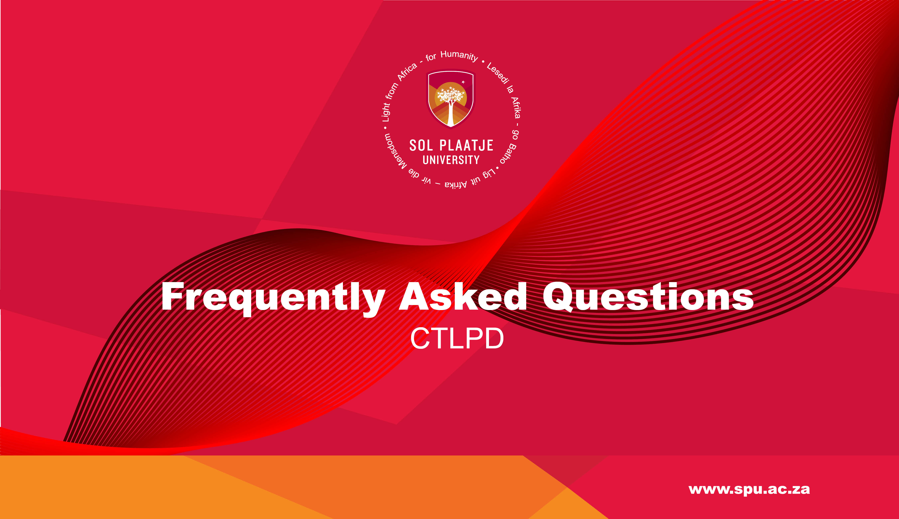
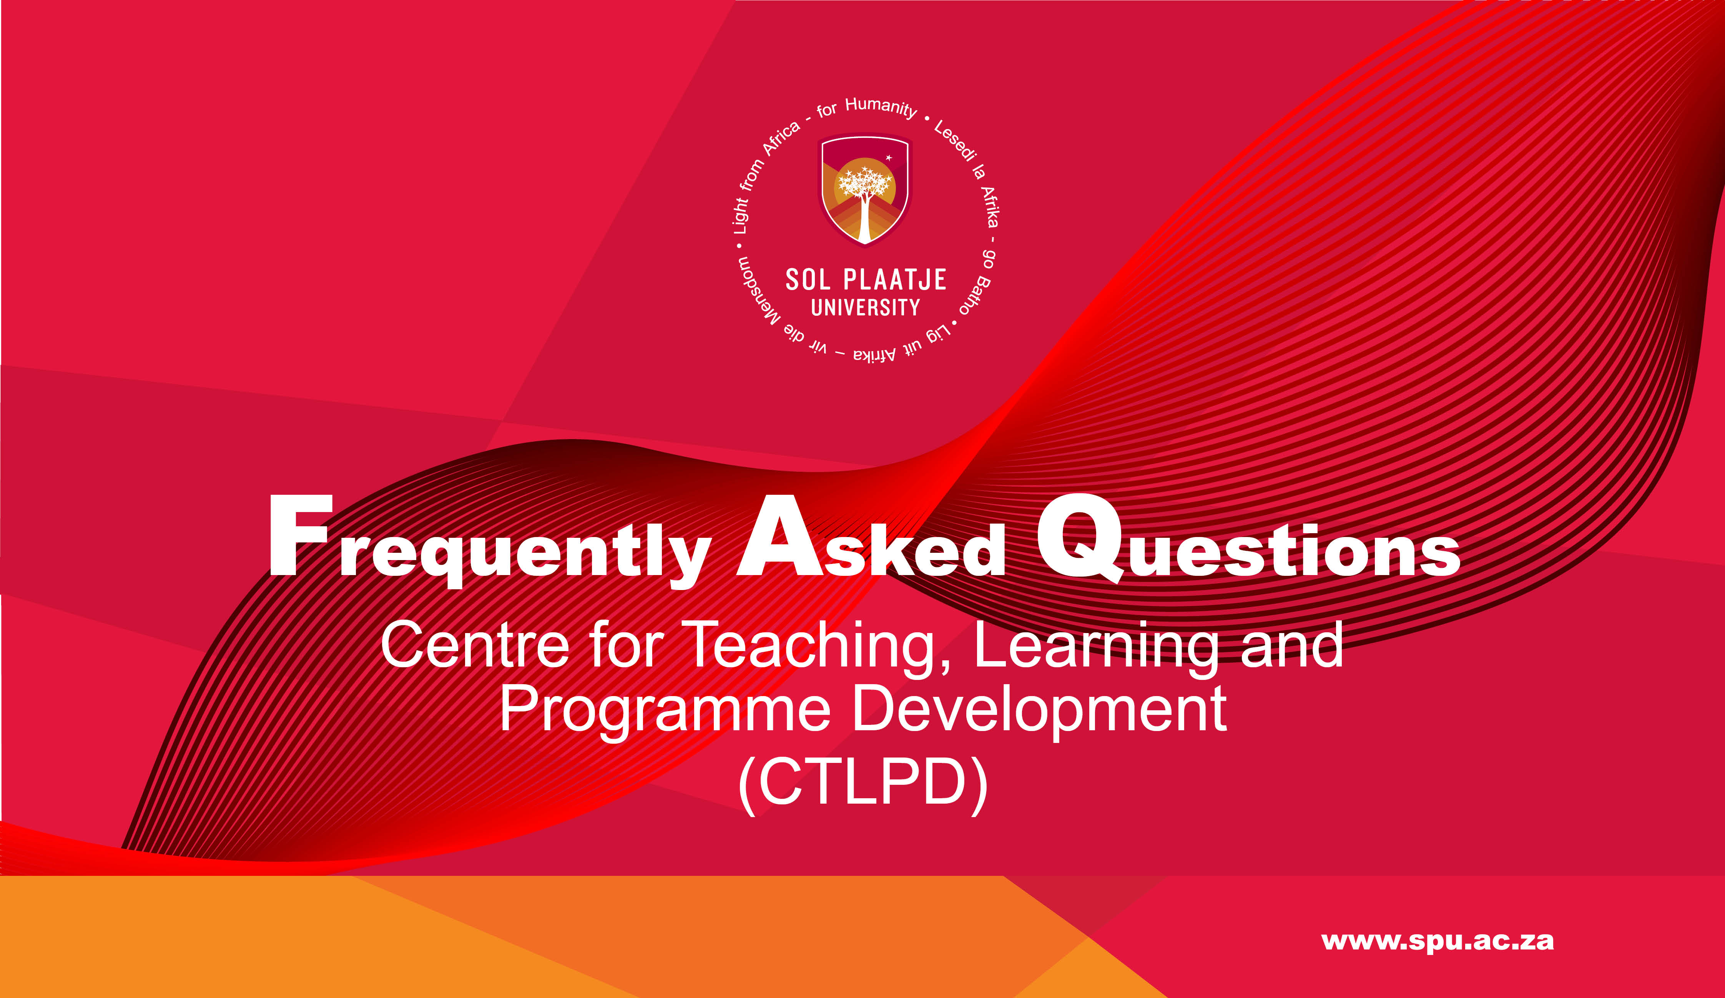
Sefako Makgatho Health Sciences University Benchmarking Exercise
Presented by:
Ms Mosima Mehlape
Manager: Communication & Marketing
Student Media Induction
Department of Institutional Advancement (DIA)
Ms Mosima Mehlape
Manager: Communication & Marketing
2 June 2023

Slide 2
CENTRE FOR TEACHING , LEARNIG AND PROGRAMME DEVELOPMENT
Q - What is academic orientation?
Academic orientation is a programme aimed at providing awareness about higher education expectations and equipping students with the necessary skills to transition into higher education effectively.

Slide 3
Q - What are the services offered in academic orientation?
Basic laptop operation
Introduction to Learning and Teaching Methodology
Introduction to the Learning management system
Self-directed learning
Student support resources

Slide 4
Q - Why shou ld I complete the academic orientation?
Provide tools to navigate higher education.
Understand the institutional policies and expectations.
Guide the learning management system.

Slide 5
Q - Where do I get support on Academic Orientation?
Academic Advisors: Email: ctlpdacademicadvising@spu.ac.za
E-Learning Help Desk: Email: ctlpd.enquiries@spu.ac.za
Face-to-face support:
Central campus, Academic Building, Ground Floor, and Room 216
Ground Floor, and Room 216.

