Slide 1
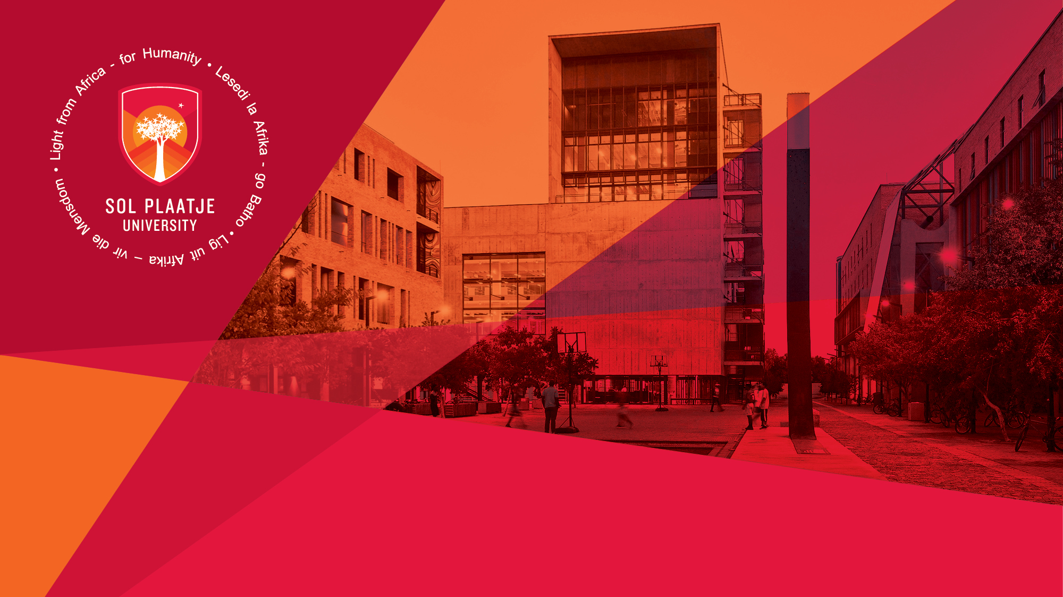
Sefako Makgatho Health Sciences University Benchmarking Exercise
Presented by:
Ms Mosima Mehlape
Manager: Communication & Marketing
Student Media Induction
Department of Institutional Advancement (DIA)
Ms Mosima Mehlape
Manager: Communication & Marketing
2 June 2023

Slide 2
SCHOOL OF EDUCATION
Q - How long does it take to study towards a BEd degree?
It will take you four full years to complete a BEd degree
Q - Can one specialize in only one teaching subject?
A student can specialize in up to five teaching subjects. Depending on the degree that you are enrolled for, you could specialize in two, three, four or five teaching subjects.
Q - Are there bursaries available for teaching?
Yes, there are various sources of funding available including FUNZA LUSHAKA and NSFAS. FUNZA LUSHAKA is a bursary scheme managed by the Department of Basic Education specifically meant for teaching students who specialize in mathematics and science related subjects. Kindly check these different websites for application dates.

Slide 3
Q - Will I be required to do teaching practice during the course of my degree?
Yes, teaching practice is meant to give teaching students exposure to the classroom context. All teaching students will be placed at schools in order to observe experienced teachers teaching. From 3rd and 4th year onwards, you will offer lessons yourself to learners.

Slide 4
Q - How to I decide my specializing subjects?
Your specializing subjects are based on the subjects you passed in grade 12. In other words, if you want to specialize in pure Mathematics, you would have needed to do pure Mathematics at school.
Q - Which grades does BEd Foundation Phase train you to teach?
BEd Foundation Phase trains you to teach grades R, 1, 2 & 3.

Slide 5
Q - Which grades does BEd Intermediate Phase train you to teach?
Intermediate phase at school refers to grades 4 to 6. If you do a BEd Intermediate Phase, you will teach grade 4 to 6 learners.
Q - What does BEd (SP) Senior Phase and Further Education and Training Phase (FET) refer to?
Senior Phase refers to grades 8 and 9 teaching. Further Education and Training Phase refers to grades 10, 11 and 12 teaching. Therefore, if you pursue a BEd SP & FET degree you would be in a position to teach subjects to students at high school.

Slide 6
Q - What does BEd (SP) Senior Phase and Further Education and Training Phase (FET) refer to?
Senior Phase refers to grades 8 and 9 teaching. Further Education and Training Phase refers to grades 10, 11 and 12 teaching. Therefore, if you pursue a BEd SP & FET degree you would be in a position to teach subjects to students at high school.
Q- Would I be in a position to start teaching immediately after completing my studies?
Yes, most teaching students get employed very fast after they have completed their degree. They therefore start teaching immediately the following year after completing their degree.

Slide 7
Q - What are the requirements to complete my degree?
You would graduate after four years only if you have passed all your modules/subjects at university in 1st year, 2nd year, 3rd year and 4th year. If you have any module outstanding at the end of your final year, you cannot graduate and need to return for a 5th year. Always ask guidance from administrative staff during registration to make sure you are registered for all modules in a particular year.

