Slide 1
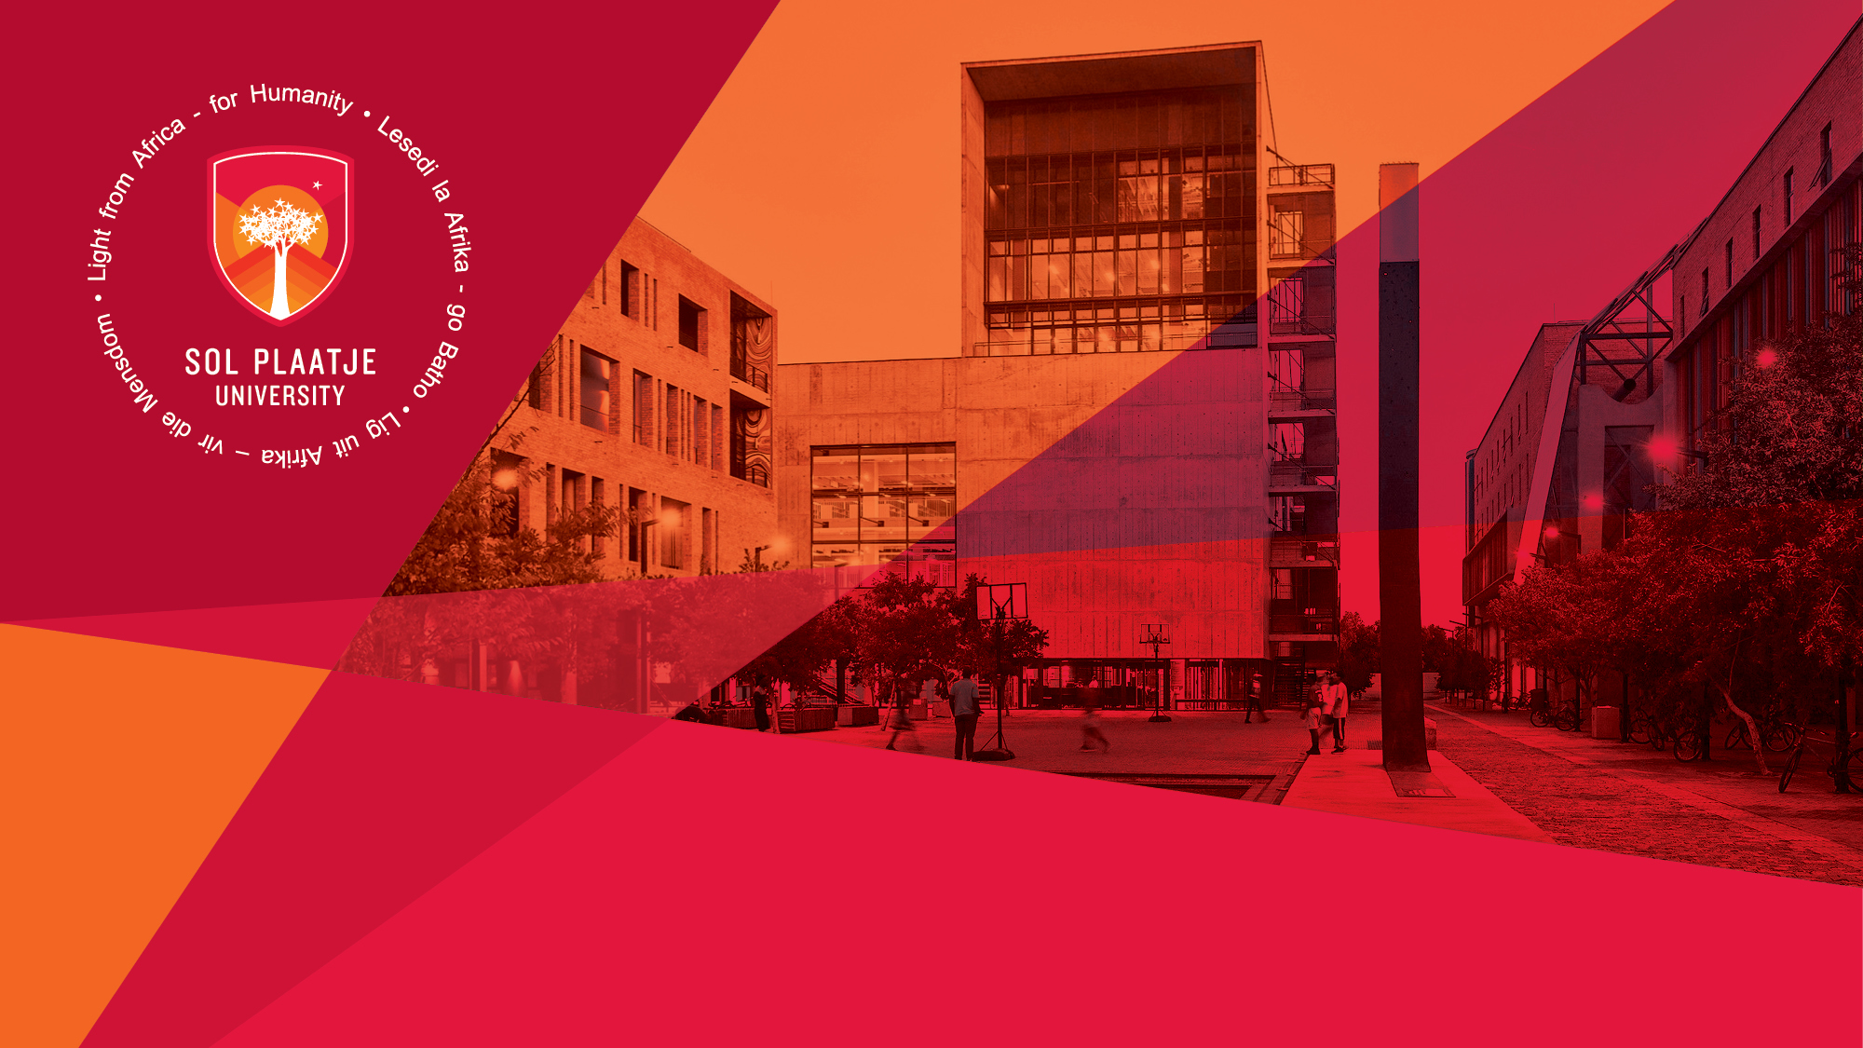
Sefako Makgatho Health Sciences University Benchmarking Exercise
Presented by:
Ms Mosima Mehlape
Manager: Communication & Marketing
Student Media Induction
Department of Institutional Advancement (DIA)
Ms Mosima Mehlape
Manager: Communication & Marketing
2 June 2023

Slide 2
FACULTY OF HUMANITIES
Q - Which modules will allow me to do a PGCE?
In order to qualify for a PGCE you must register for a minimum of two (2) School Subjects. School subjects are subjects that are taught at School level either on intermediate phase or senior phase. The school subjects that can be selected with the BA Degree are: - History - Geography - Afrikaans - English - Setswana – IsiXhosa
Q- How do I apply for NSFAS?
Applications for NSFAS are done online. https://applynsfas.com/ . Follow the steps and ensure that you upload all the required certified documents when you apply. If you experience any challenges, contact SPU Student funding office on finance.enquiries@spu.ac.za ALWAYS indicate your student number in all communication.

Slide 3
Q - What does NSFAS pay for?
NSFAS covers all study programmes of registered public higher education institutions in South Africa. If your NSFAS is approved it will cover tuition fees, book fees, residence fees, meal allowances. NSFAS will only cover you for a maximum of 4 years of your studies. NSFAS only covers one (1) undergraduate qualification. This means, if you have completed a diploma course and was funded by NSFAS then you will not receive funding for a second undergraduate qualification. NSFAS does not cover postgraduate qualifications.

Slide 4
Q - I do not know who to contact at SPU if I am unsure about anything related to my student financial account or NSFAS payment
Kindly email finance.enquiries@spu.ac.za. Please provide your full names and student number when you send an email. It is preferable to communicate using only your SPU registered email address. Your email communication to our student funding office should indicate a detailed description of your problem to ensure that is directed to the relevant person to assist you with your issue.

Slide 5
Students are urged to first try and log onto their NSFAS portals to determine issue related to statuses and appeals. Some issues can only be resolved by contacting NSFAS directly and provide them with your I.D number and NSFAS registered reference number. Always have this at hand when contacting NSFAS.

Slide 6
Q - What will my degree allow me to do?
This will depend on your choice of specialisations (the majors / elective you chose on first year level). It is advisable that you attend the schooled academic orientation programme for first year students where we discuss career trajectories and postgraduate studies related to each discipline on offer at the School of Humanities. See details below.

Slide 7
Q - I am not happy with the majors / electives that I chose when I registered for the first time. What can I do to change this?
There is module change periods for each semester of the academic year. Module change for all first semester modules ends 01 March 2024. For all second semester modules, the module change period is from 15 July – 26 July 2024. There is a form you need to complete. It is advisable to first have discussions with the academic advisor, Mr Brendan Thomas, to discuss the request to change modules to ensure that what you changing to aligns with your future plans and your understanding of the various electives. Contact Ms Mentor to schedule an appointment on brendan.thomas@spu.ac.za The School will also host a second orientation session that will provide you with an overview of all the electives in the school together with study and career path trajectory.

Slide 8
Q - I want to cancel my studies; how do I do this?
There are two different processes when a student wishes to cancel studies. Option A: Cancelation of Studies Cancelation of studies means that you are cancelling your studies entirely and you will need to reapply for admission to study at SPU. Students may not cancel studies a MONTH BEFORE the examination period or the close of the semester. However, if the request for cancelation is based on medical grounds or any legal reason the final decision on the approval of the cancelation remains the discretion of the University Registrar. If the cancelation is approved, you are still liable for a percentage of the year’s fees based on the date of cancelation. Cancelation fees are calculated as follows: - Cancelation after 31 March 2024, you are liable for

Slide 9
25% of the annual fees (Sem. 1) - Cancelation after 30 April 2024, you are liable for 50% of the annual fees (Sem. 1) - Cancelation after 31 August 2024, you are liable for 75% of the annual fees (Sem. 2) - Cancelation after 30 September 2024, you are liable for 100% of the annual fees. (Sem 2)
If you were funded by any entity such as NSFAS, you must liaise with the respective funder whether they will continue funding you if you wish to reapply and whether they will cover the fees based on the time of your cancelation for the year. If you were not funded and you have not yet fully paid for the SPU Issued laptop, you must return the laptop with the cancelation. However, if you were funded and you have fully paid, then there is no need to return the laptop.

Slide 10
OPTION B: Interruption of Studies: An interruption of studies means you do not cancel your enrolment with SPU entirely; you basically pause it for the academic year and return next year to continue. There would then not be a need to reapply for admission. However, please note the following related to an application for an interruption of studies: - Based on your reason for an interruption of studies you must submit supporting evidence. For example, if your reason is medically related medical reason, you must submit a medical letter. - Like a cancelation of studies, if you were funded by any entity such as NSFAS, you must liaise with the respective funder whether they will continue funding you when you return to SPU the following year to continue your studies and whether they will cover the fees based on the time of your interruption of studies. - Students may not interrupt studies a MONTH BEFORE the examination period or the close of the semester. However, if the request for an interruption of studies is based on medical grounds or any legal reason the final decision on the approval of the cancelation remains the discretion of the University Registrar. The final decision on all applications for cancelation of studies and interruption of studies remains the discretion of the University Registrar. Kindly note that an application does not automatically mean approval. The outcome for each application will be communicated to students.

Slide 11
Q - I am pregnant, how does it affect my studies?
Unfortunately, SPU does not have a maternity leave policy for students. Students who fall pregnant have 2 options: Option 1: Apply for an interruption of studies and continue studies later. Option 2: If the student chooses to continue studies and a lecturer has sit down (Face to face) assessments scheduled, they (the student) should avail themselves for all sit-down assessments. Lecturers are not compelled to give concession. However, if the lecturer is willing to assist the student, it remains the discretion of the lecturer and any arrangements made with 1 lecturer of a module will not be imposed

Slide 12
on another lecturer. The student would therefore need to have arrangements in place with ALL lecturers for modules she is registered for. As callous has it sounds, it is unfortunately the situation at all institutions. The only policy at SPU regarding pregnancy is that students must vacate SPU residence at 7 months of pregnancy.

Slide 13
Q- I want to change programmes:
Programme changes should be submitted to the school you wish to change to. Please note that the school makes the decision based on availability of space within the programme you wish to change to as well as whether you qualify for the programme you wish to change to. It is also advisable to contact your funder (if you are funded) on whether the change would be permitted

Slide 14
Q - I want to transfer to another university
There is no formal process for transfers from academic administration, which means there are no forms you need to complete from the School’s side for the transfer. You will need to cancel your studies at Sol Plaatje University if you intend on leaving mid-year / midsemester. However, if you are completing the year with SPU, then there is no need to formally cancel studies. If you have applied at another institution and you have been accepted, you simply do not return to SPU to continue your academic registration for the continuing years at SPU. Kindly note the following:

Slide 15
1.It remains your responsibility to inform your funder of the change of institution. This is to ensure that the funder does not send the fees for your studies to SPU. Additionally, this is also to ensure that the funder permits the change of institution.
2. If you complete the academic year with SPU with the intention of not returning, kindly inform my office by 10 January 2023. 3. Changing from SPU to another institution does not mean that you will automatically be credited / exempted for modules passed at SPU. You will need to liaise with new institution on their processes and policies for exemption of credits for modules passed.

